Slide 1

Eff {Strings} logo
Amber
Christian
Ishmael
Steve

Slide 2
Background
Last.fm is a global application created in the UK by founders in Germany and Austria in 2002
that builds a profile of users’ musical taste based on the songs a user listens to on internet
radio, their PC, or other portable music devices.
Last.fm CEO has tasked music supervisors with recommending and selecting appropriate
music and licenses to provide on their app.
Music Supervisors are analyzing global music data against Gross National Product (GNP)
To determine whether economic indicators affect listeners and play counts. This
information will inform the most profitable music selections globally, providing guidance
to inform Music Supervisors’ selection criteria.

Slide 3
Hypothesis
Null Hypothesis:
GDP has no relationship to listeners.
Alternative Hypothesis:
If GDP is lower, Last.fm will have a higher listenership.
Imagine- Lennon

Slide 4
Limitations
No time frame or trending ability
Of all music sources, we are looking at one source.
Listeners vs. population
No demographic population
Manual cleanup of data was necessary
API documentation appeared to be dated

Slide 5
Questions
Which artist are most popular based on their country play count?
Which countries’ users engage the most with the app?
Who are the top artists in the country with the highest listener count?
What is the average replayability globally? (With over 1 Million listeners)
Who are the top 5 artists globally?
What is the GDP and play count of each country?
What is the GDP and play count of each country?

Slide 6
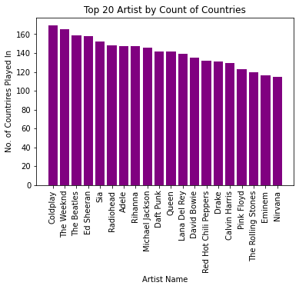
Data demonstrates that:
Coldplay
The Weekend
The Beatles
Ed Sheeran
Sia
Radiohead
Adele
Data shows how often artists are listened to regardless of listener (or user)
Music quote here

Slide 7
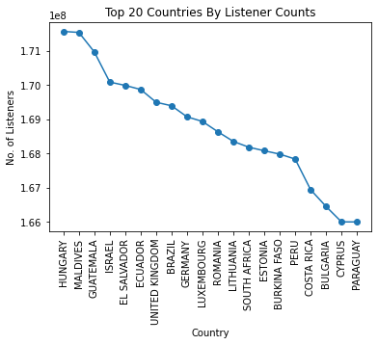
Which countries’ users engage the most with the app?
Hungary has the most users engaged as a sum of listener count with the app, followed closely with Maldives.
Followed by
Guatemala
Israel
El Salvador
Ecuador
United Kingdom
Music quote here

Slide 8

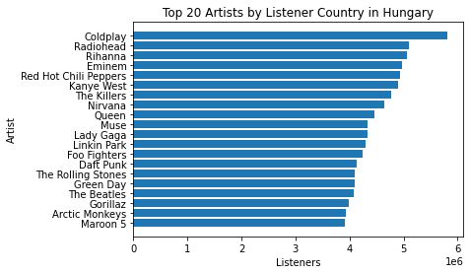
Who are the top artists by listener count in the country with the highest overall listener count (Hungary)?
Amber
The top artists listened to in Hungary, which has
the highest listener (or user) count, are:
This sets a standard for other countries.
Music quote here

Slide 9
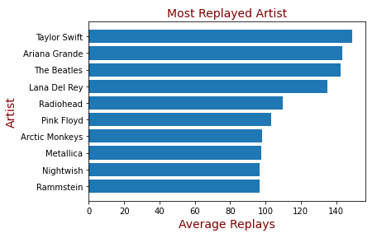
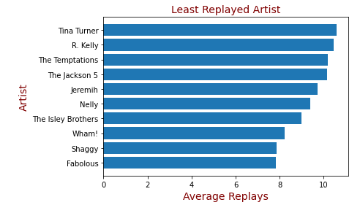
What is the average replayability globally? (With over 1 Million listeners)
Music quote here

Slide 10
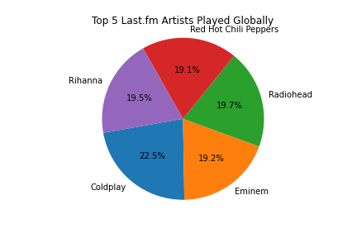
Which 5 artists are played most often globally?
Top 5 artists that are played the most globally are
This demonstrates the universal popularity of any
given artist, from which one can extract genre:
Bye Bye Ms. American pie
Don Mclean

Slide 11
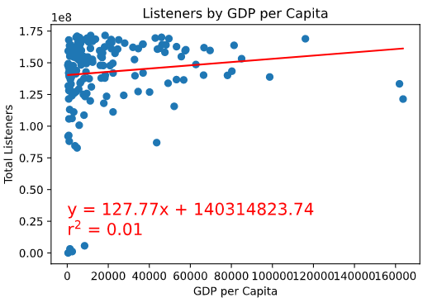
What is the GDP and play count of each country?
Null Hypothesis:
GDP has no relationship to listeners.
Alternative Hypothesis:
If GDP is lower, Last.fm will have a higher listenership.
We can conclude that there is no relationship between country GDP per capita and listenership.
Therefore we can fail to reject the null hypothesis.

Slide 12
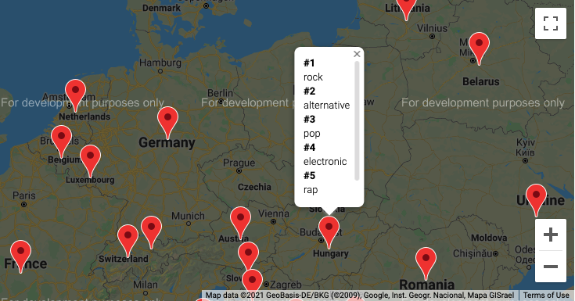
What is the GDP and play count of each country?
Bonus- Genre Searcher
Looking at country, you can find the top 5 genres.
“What a wonderful world”

Slide 13
Lessons Learned
More decisiveness in selection of data
Data sets were better for application development rather than data science
Understanding and agreeing on the ask
More frequent communication
“What a wonderful world”

